Slide 1












(a) A coherent Set (CS)
(b) Coherent and Incoherent Alternating Structure
Incoherent layer
L₀
ray optics
Layer 1
$$\overset{̿}{ε_{1}}\left(λ\right)$$
$$d_{1}=∞$$
CS:1
EM wave optics
Layer 2
$$\overset{̿}{ε_{2}}\left(λ\right)$$
$$d_{2}$$
L₁
ray optics
$$……$$
CS:2
EM wave optics
$$\hat{z}$$
ray optics
$$\overset{̿}{ε_{i}}\left(λ\right)$$
$$d_{i}$$
Coherent Set
$$……$$
EM wave optics
$$……$$
$$……$$
ray optics
Layer m-1
$$\overset{̿}{ε_{m−1}}\left(λ\right)$$
$$d_{m−1}$$
CS:n-1
EM wave optics
Layer m
$$\overset{̿}{ε_{m}}\left(λ\right)$$
$$d_{m}=∞$$
Incoherent layer
L_{n-1}
ray optics
CS:n
EM wave optics
L_{n}
ray optics

Slide 2
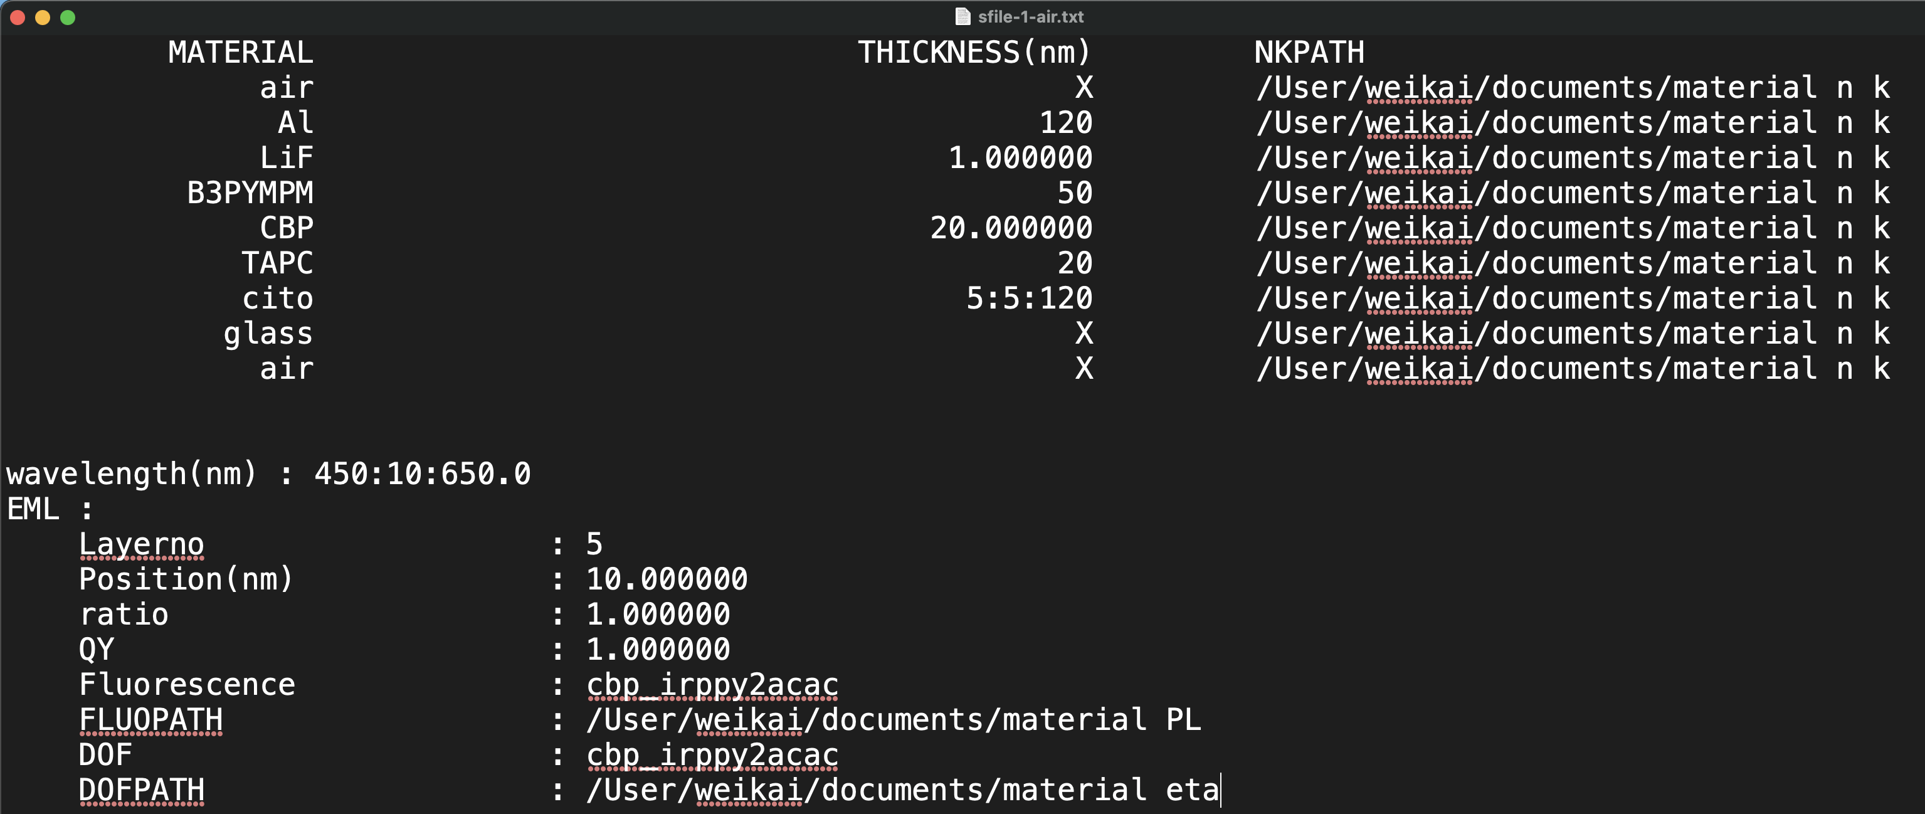
Part I. material order & thickness (necessary)
optional
Layer 1.
Layer 2.
Layer 3.
Layer 4.
z
Layer 5.
Layer 6.
Layer 7.
Layer 8.
Layer 9.
Part II. Emission wavelength (optional)
Part III. emitting properties (optional)
optional

Slide 3
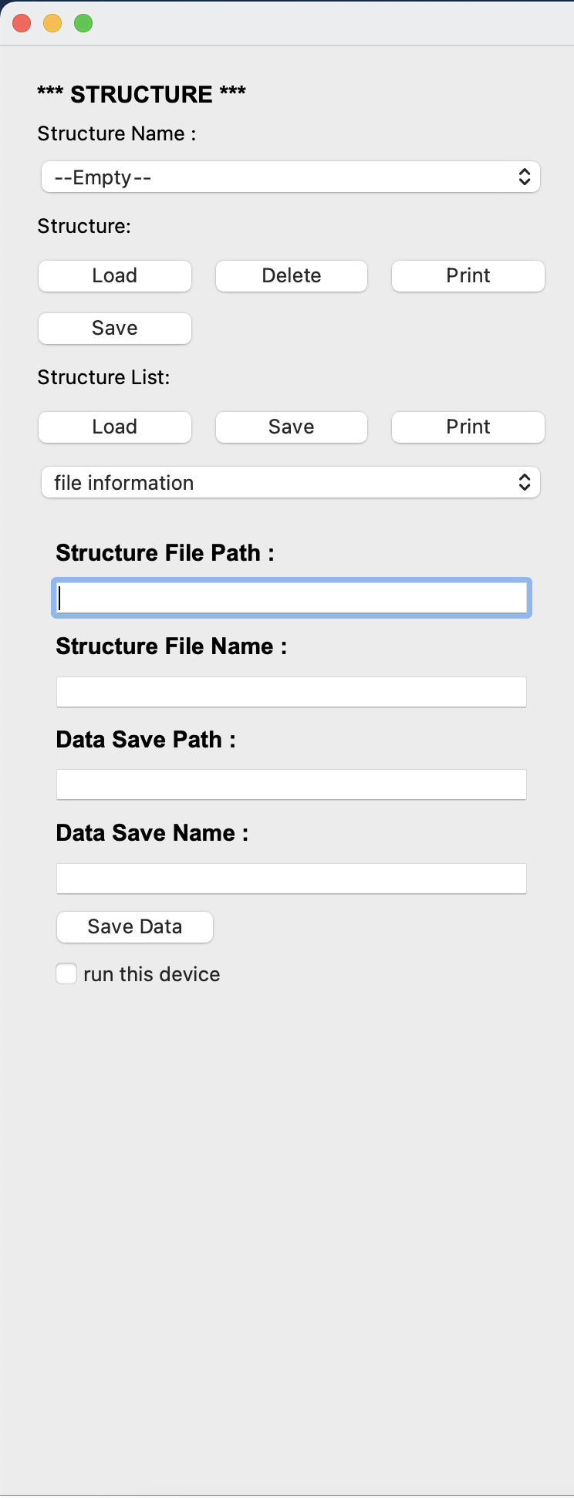
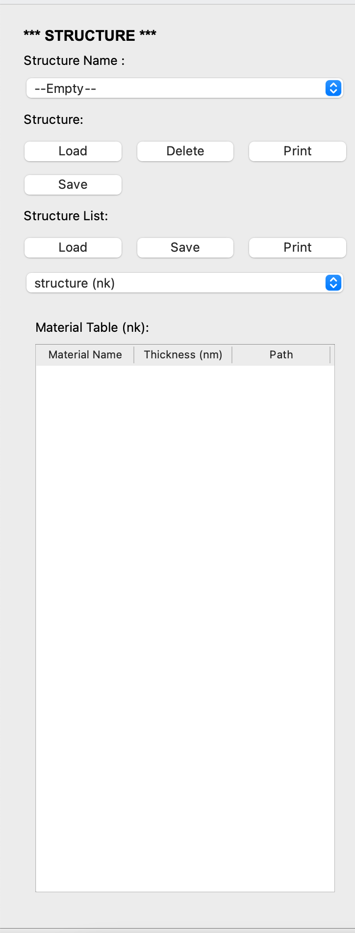
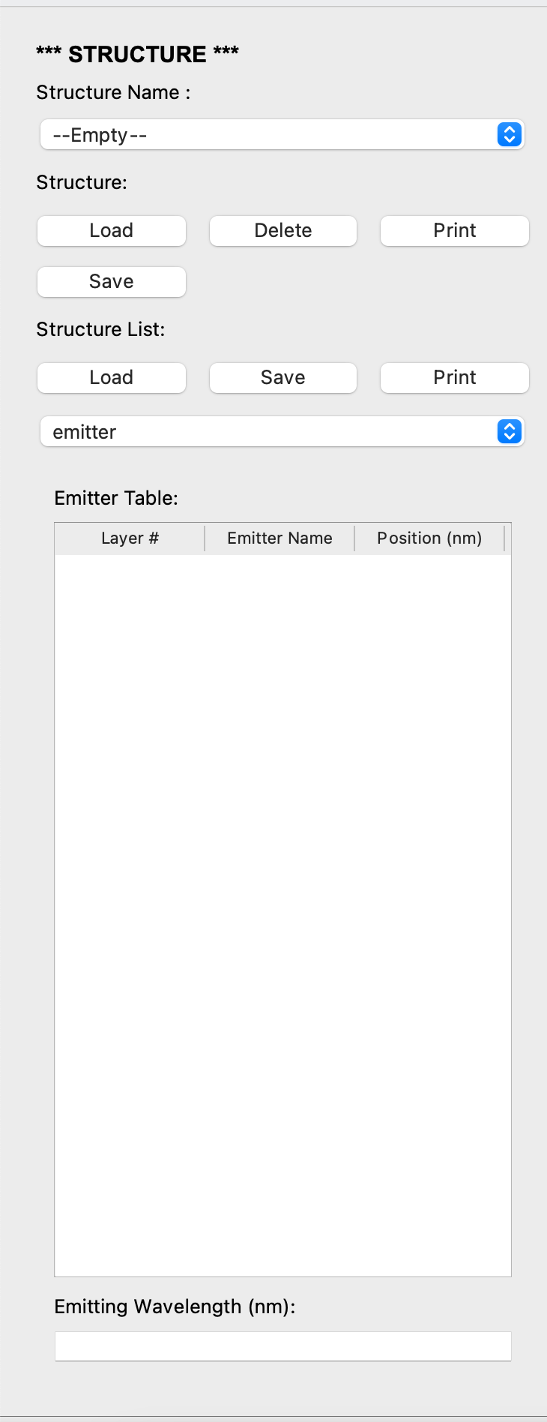
file information
structure (nk)
emitter

Slide 4
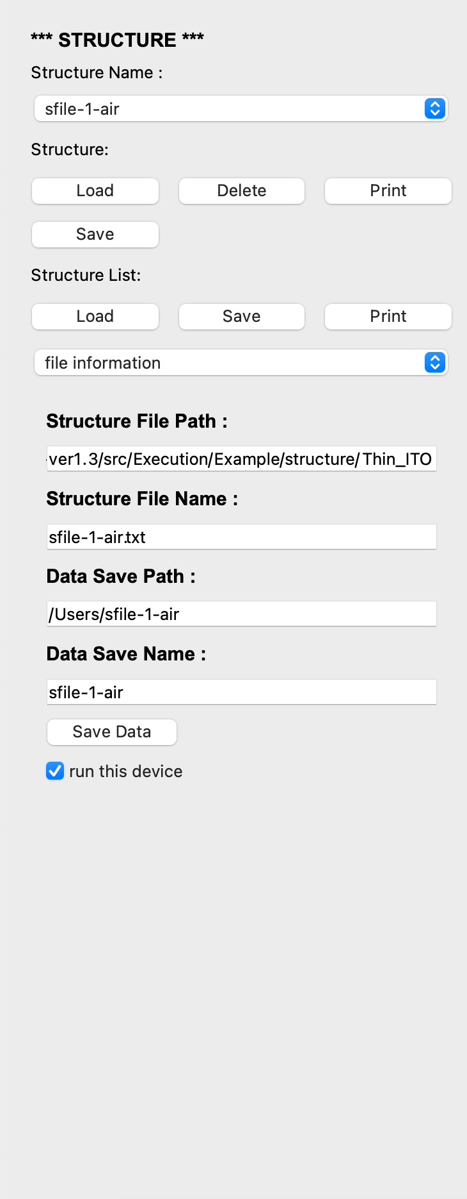
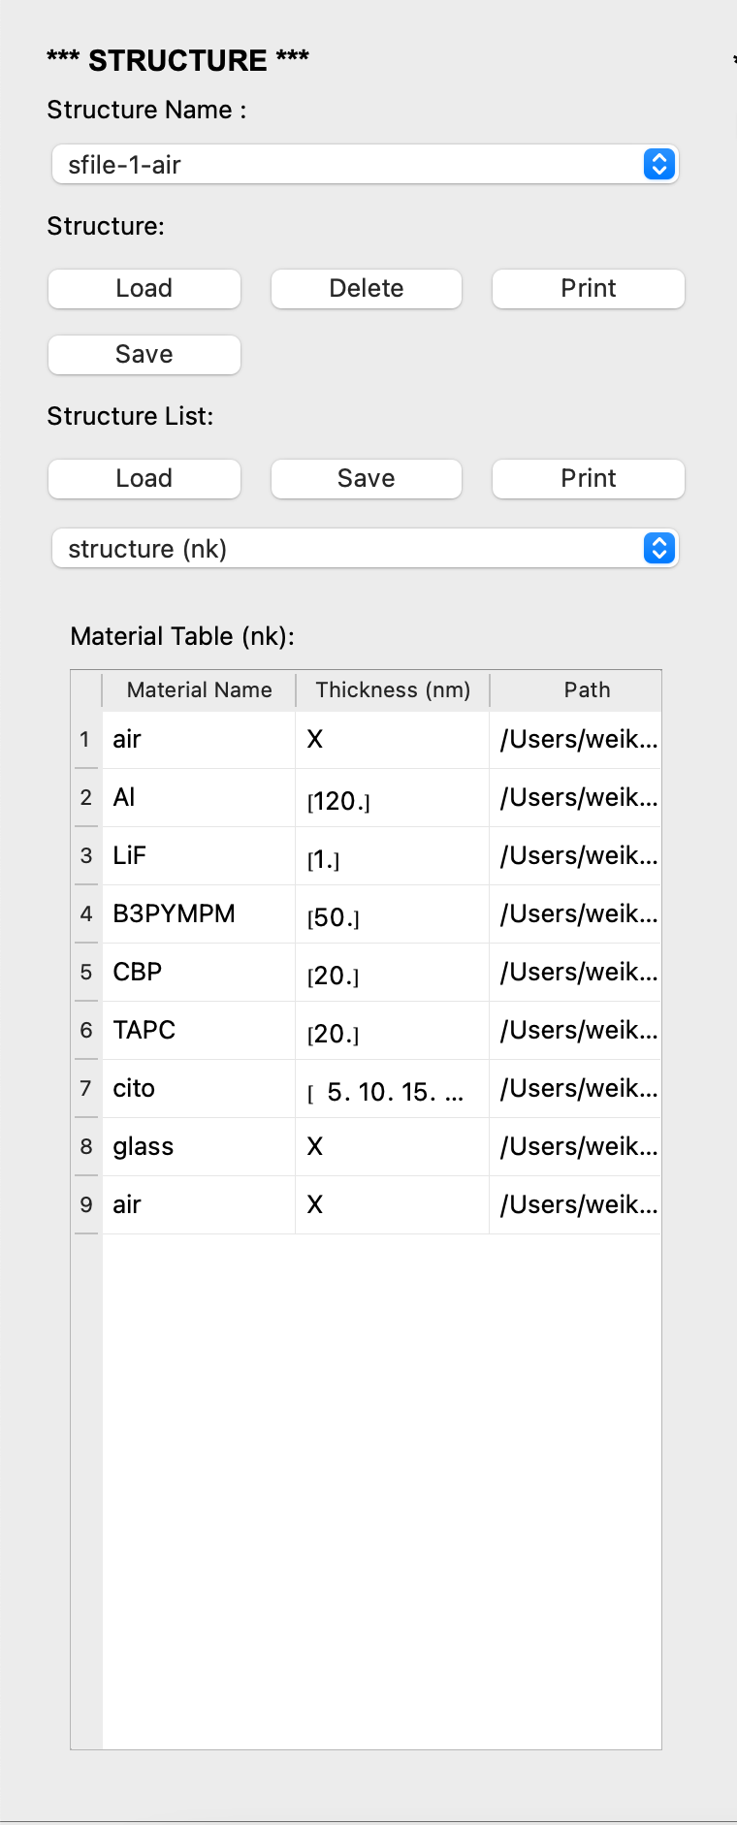
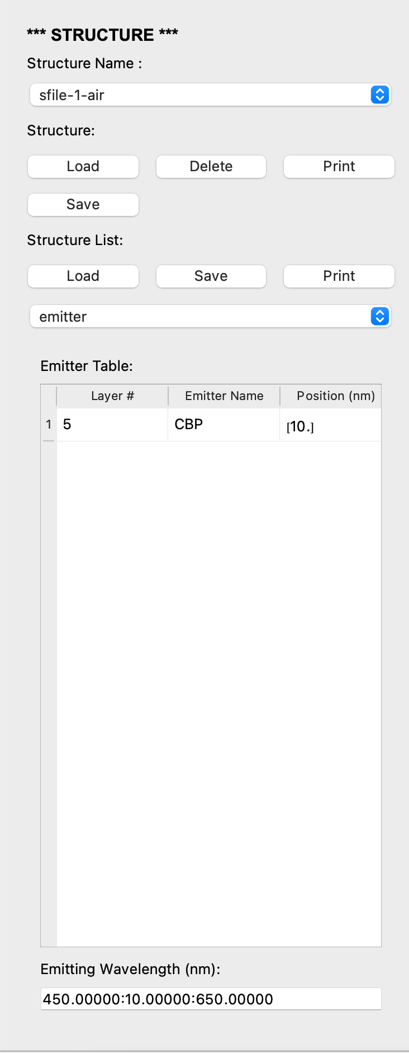
file information
structure (nk)
emitter

Slide 5
